Slide 1

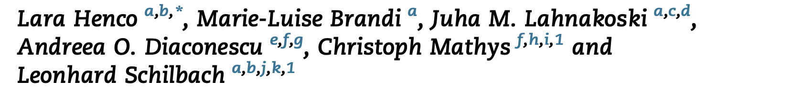
Bayes modeling captures inter-individual differences in social belief computations in the putamen and insula
臧仲尧
2022.6.17

Slide 2
Non-social and social cues
Notes:
同时收的Motor execution和motor imagery任务，拿来做localizer

Slide 3
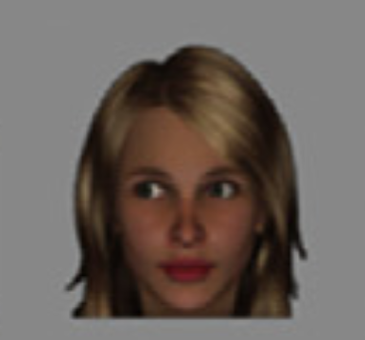
Non-social and social cues
Notes:
同时收的Motor execution和motor imagery任务，拿来做localizer

Slide 4
Introduction
Successful social interaction requires learning from others and making decisions that in turn lead to rewarding experiences.
Although similar to reward learning in non-social contexts, Social Learning is thought to engage different processes by which Not Only Reward Associations Are Learned, but also the Hidden Traits (Hackel, Doll, & Amodio, 2015) or States (e.g., intentions) (Diaconescu et al., 2017) which may modulate these associations.
Accordingly, Social Learning has been found to Engage Brain Regions That May Have a Unique Role In Social Cognition in addition to the neural circuitry involved in non-social learning (Joiner, Piva, Turrin, & Chang, 2017; Lockwood & Klein-Flu ̈ gge, 2020; Ruff & Fehr, 2014; Wittmann, Lockwood, & Rushworth, 2018).
Notes:
同时收的Motor execution和motor imagery任务，拿来做localizer

Slide 5
But
The Majority Of Studies, which investigated the neural correlates of learning the trustworthiness of others, thereby probing mentalization, Instructed Participants Explicitly To Learn From A Partner’s Advice（具有外在指导） (Behrens et al., 2008; Diaconescu et al., 2017).
Most everyday life social interactions, however, require us to Automatically Infer on Mental States by using Nonverbal Signals such as Gaze Behaviour (Schilbach et al., 2013).
Therefore, in the current study, we decided to investigate The Neural Mechanisms Of Uninstructed Social Learning And Decision-Making by means of functional magnetic resonance imaging (fMRI).
Notes:
同时收的Motor execution和motor imagery任务，拿来做localizer

Slide 6
Behavior——Model——fMRI
①To this end, we employed an established probabilistic learning task (Sevgi, Diaconescu, Henco, Tittgemeyer, & Schilbach, 2020) in which participants can learn from two types of information, i.e., a non-social cue (cards with different colours) and a social cue (gaze shift of a face pre- sented in the centre of the screen).
②Three types of computational models of learning and decision-making were used to fit participants’ choices. These models varied in their complexity of the belief updating process and have been employed in previous studies of learning under uncertainty.
③The Learning Trajectories as well as the Weighting Factor from the best performing model, the Hierarchical Gaussian Filter (HGF; Mathys et al., 2014; Mathys, Daunizeau, Friston, & Stephan, 2011), Were Used As Predictors In Model-based fMRI Analysis to uncover the neural mechanisms of social and non- social learning and decision-making.
Notes:
同时收的Motor execution和motor imagery任务，拿来做localizer

Slide 7
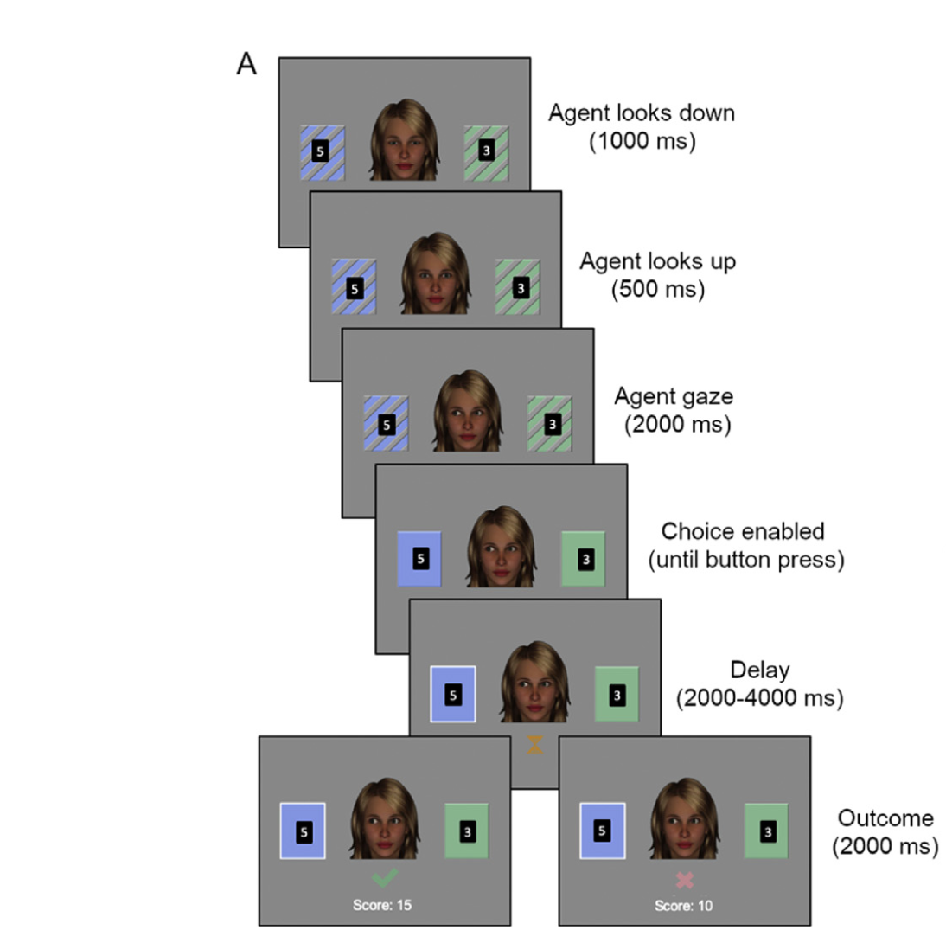
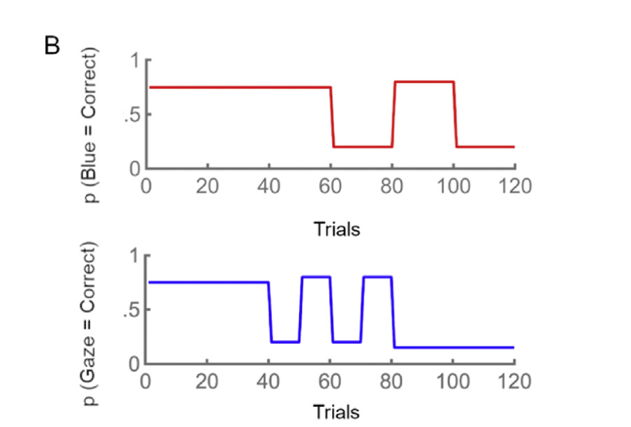
Step1: Behavior --- Experiment Design
Participants: 50 (25 female; mean age 24.8 ± 5 years, range: 18-48 years).
Within subject factor :
Task phase divided by cue accuracy
( high vs volatile vs low )
120 trials → about 20min
In addition, participants filled out a post-experimental questionnaire to assess the subjective learning experience during the task, asking How Difficult The Task Was (From 0 to 100), How Much They Used The Gaze (From 0 to 100) and How Much It Helped Them During The Task (from 0 to 100).
Eye-tracking
Notes:
同时收的Motor execution和motor imagery任务，拿来做localizer

Slide 8
Step2: Computational Modeling --- Perceptual and Response
The modelling approach followed the “observing the observer” framework in which two types of models (perceptual and response models) are paired in order to allow the inference of an observer (i.e., the experimenter) on the inference of a participant:
Perceptual models describe the participant’s belief trajectories about the hidden causes (states) of the sensory inputs (here: social and non-social cue);
Response models describe how these beliefs are translated into decisions (Daunizeau et al., 2010).
Notes:
同时收的Motor execution和motor imagery任务，拿来做localizer

Slide 9
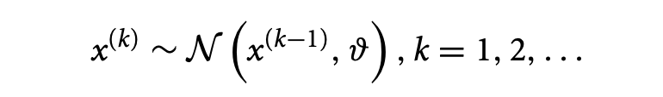
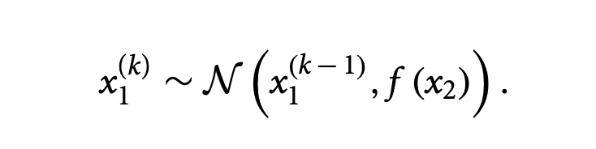
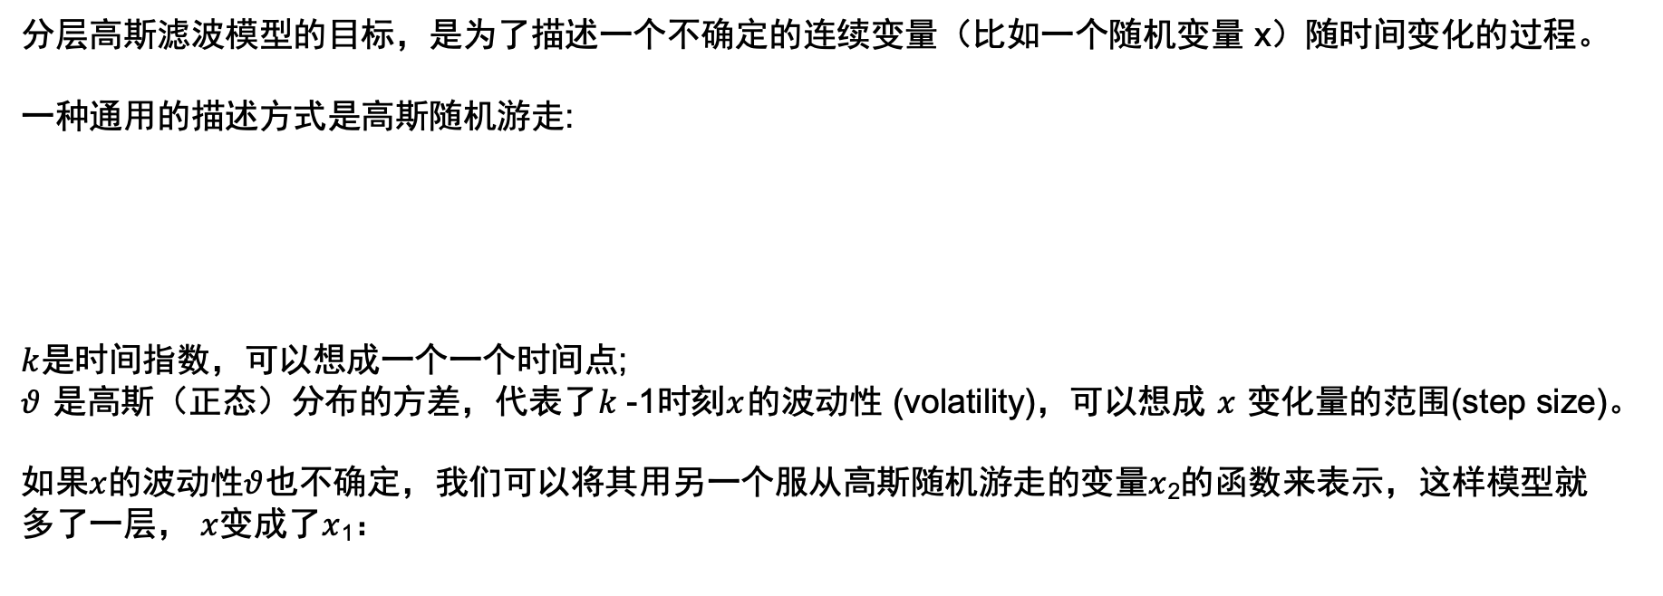


Step2: Perceptual model —— Hierarchical Gaussian Filter
(分层高斯滤波)
分层高斯滤波模型的目标，是为了描述一个不确定的连续变量（比如一个随机变量 x）随时间变化的过程。
一种通用的描述方式是高斯随机游走:
$k$是时间指数，可以想成一个一个时间点;
$θ$ 是高斯（正态）分布的方差，代表了$k$-1时刻$x$的波动性 (volatility)，可以想成 $x$ 变化量的范围(step size)。
如果$x$的波动性$θ$也不确定，我们可以将其用另一个服从高斯随机游走的变量$x$₂的函数来表示，这样模型就多了一层， $x$变成了$x$₁：
$$x_{2}^{(k)}\sim 𝒩(x_{2}^{\left(k−1\right)}, θ)$$
如果$x$₂的$θ$也不确定，我们可以继续增加层数，直到有一层的$θ$固定下来
Notes:
同时收的Motor execution和motor imagery任务，拿来做localizer

Slide 10
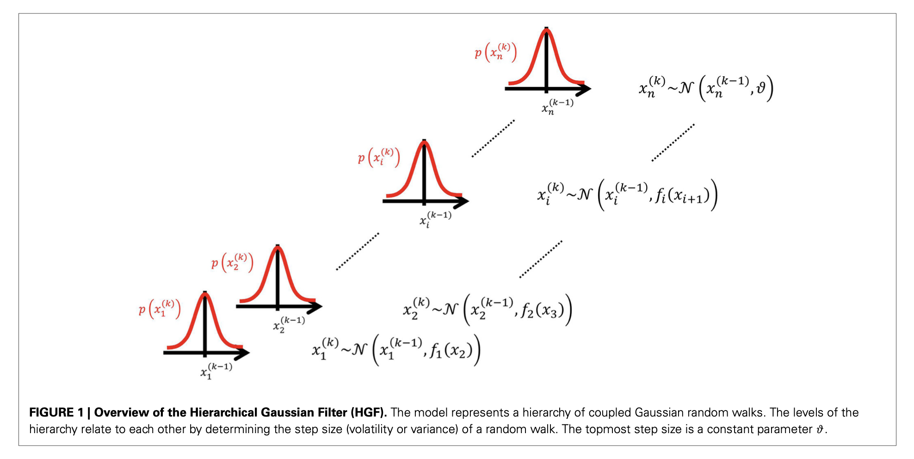
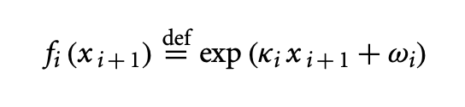


Step2: Perceptual model —— Hierarchical Gaussian Filter
Generative Model 生成模型
一阶自回归方程AR(1)
没有外界输入的时候，每一层的变化量都由上一层决定，除了顶层,因此变化的传导方向是从上到下的。
层数越高，好像越接近认知过程的本质规律…
Notes:
同时收的Motor execution和motor imagery任务，拿来做localizer

Slide 11
Step2: Perceptual model —— Hierarchical Gaussian Filter
Inversions Of Generative Models of the Sensory Inputs 贝叶斯过程
不过，当最低一层有感觉数据的输入时，我们就可以将数据自下而上传递，最终获得每一层更新后的后验分布。
Notes:
同时收的Motor execution和motor imagery任务，拿来做localizer

Slide 12
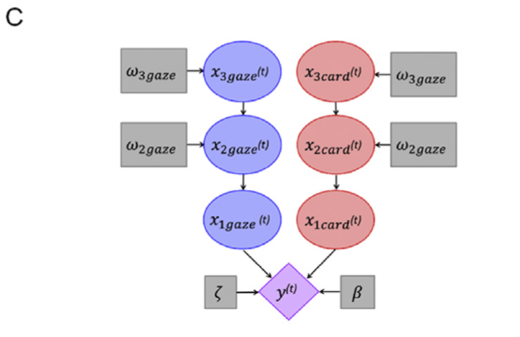
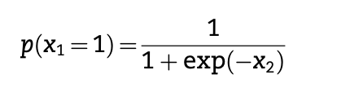

Step2: Perceptual model —— Hierarchical Gaussian Filter
(分层高斯滤波)
This approach assumes that participants are dynamically updating their beliefs (i.e., posterior probability distributions) in order to infer on the hidden environmental states x that cause the experienced sensory inputs.
In the generative model, these “to-be-inferred-on” states are coupled in a three- level hierarchy:
The lowest level x_{1 gaze} represents the accuracy of the gaze in a binary form (1 = correct, 0 = incorrect)（注视一侧正确的概率）;
The probability of x₁ is a sigmoid transformation of x₂.
Level x_{2 gaze} represents the tendency of the gaze to be correct or incorrect，evolves as a Gaussian random walk with a step size determined by the state at the third level ;
Level x_{3 gaze} represents the volatility of this tendency to be accurate，evolves as a first-order autoregressive (AR(1)) process.
注视部分的生成模型
Notes:
同时收的Motor execution和motor imagery任务，拿来做localizer

Slide 13
Step2: Perceptual model —— Hierarchical Gaussian Filter
(分层高斯滤波)
In the generative model, these “to-be-inferred-on” states are coupled in a three- level hierarchy:
Correspondingly, the lowest level x_{1 card} represents the accuracy of the blue card in a binary form (1 = correct, 0 = incorrect)（蓝色卡牌正确的概率）;
Level x_{2 card} represents the tendency of the blue card to be correct or incorrect；
Level x_{3 card} represents the volatility of the tendency of the blue card to be correct.
卡牌部分的生成模型
Notes:
同时收的Motor execution和motor imagery任务，拿来做localizer

Slide 14
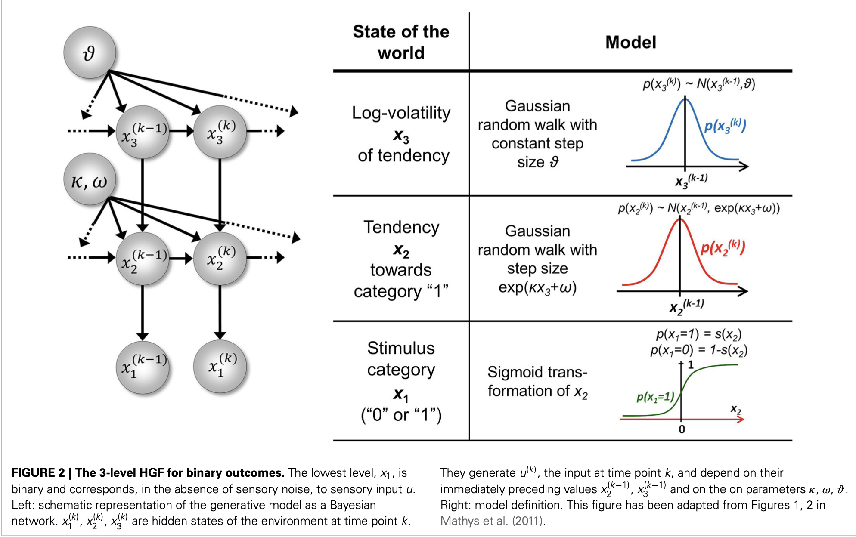
Step2: Perceptual model —— Hierarchical Gaussian Filter
(分层高斯滤波)
Notes:
同时收的Motor execution和motor imagery任务，拿来做localizer

Slide 15
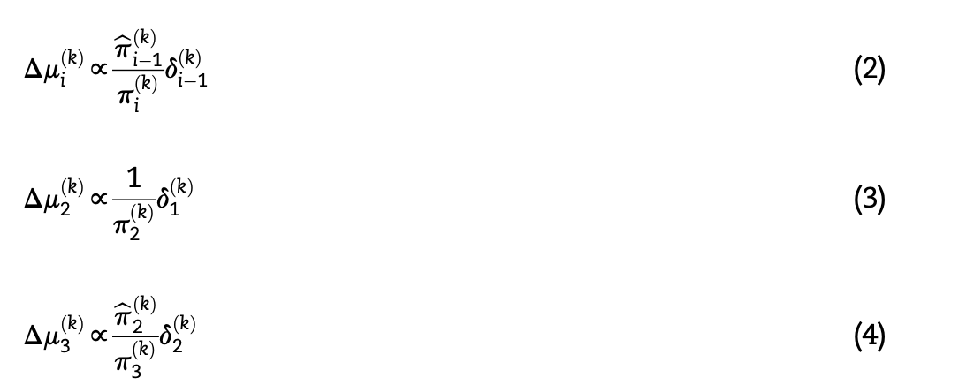
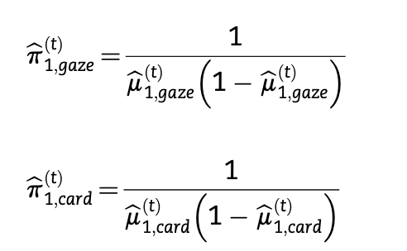
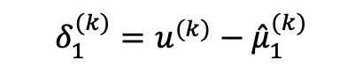
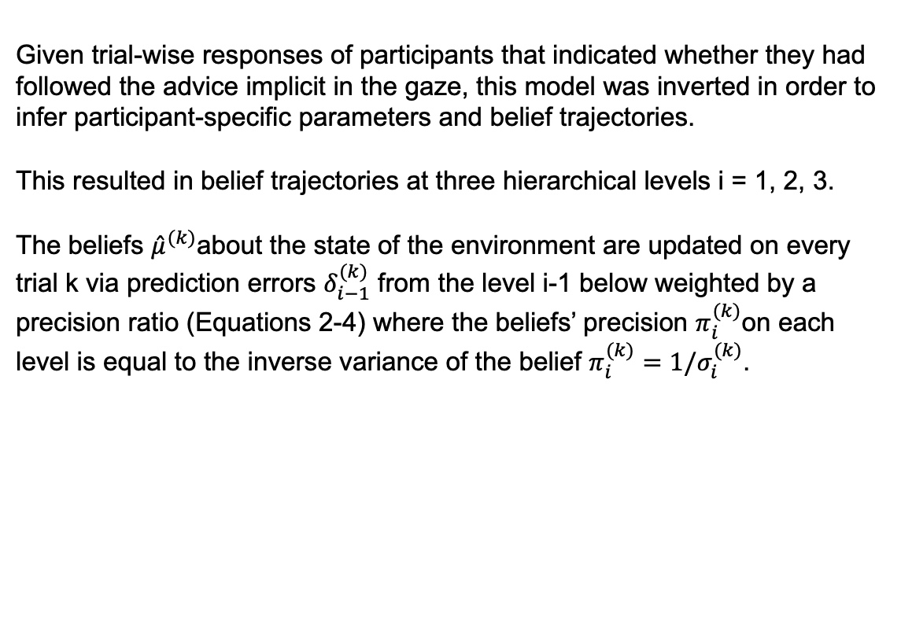
Step2: Perceptual model —— Hierarchical Gaussian Filter
(分层高斯滤波)
Given trial-wise responses of participants that indicated whether they had followed the advice implicit in the gaze, this model was inverted in order to infer participant-specific parameters and belief trajectories.
This resulted in belief trajectories at three hierarchical levels i = 1, 2, 3.
The beliefs ${\hat{μ}}^{(k)}$about the state of the environment are updated on every trial k via prediction errors $δ_{i−1}^{(k)}$ from the level i-1 below weighted by a precision ratio (Equations 2-4) where the beliefs’ precision $π_{i}^{(k)}$on each level is equal to the inverse variance of the belief $π_{i}^{(k)}=1/σ_{i}^{(k)}$.
$$δ_{1}^{(k)}=u^{(k)}−{\hat{μ}}_{1}^{(k)}$$
Notes:
同时收的Motor execution和motor imagery任务，拿来做localizer

Slide 16
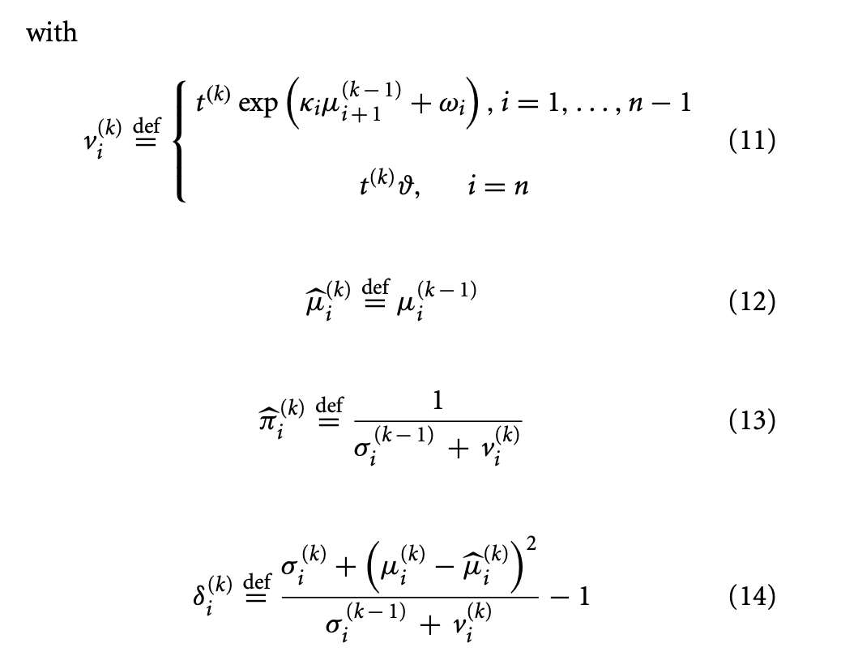
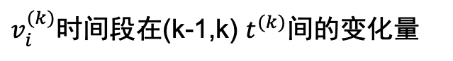
Step2: Perceptual model —— Hierarchical Gaussian Filter
(分层高斯滤波)
$v_{i}^{(k)}$时间段在(k-1,k) $t^{(k)}$间的变化量
Mathys, Christoph D et al. “Uncertainty in Perception and the Hierarchical Gaussian Filter.” Frontiers in human neuroscience 8 (2014): 825–825. Web.
Notes:
同时收的Motor execution和motor imagery任务，拿来做localizer

Slide 17


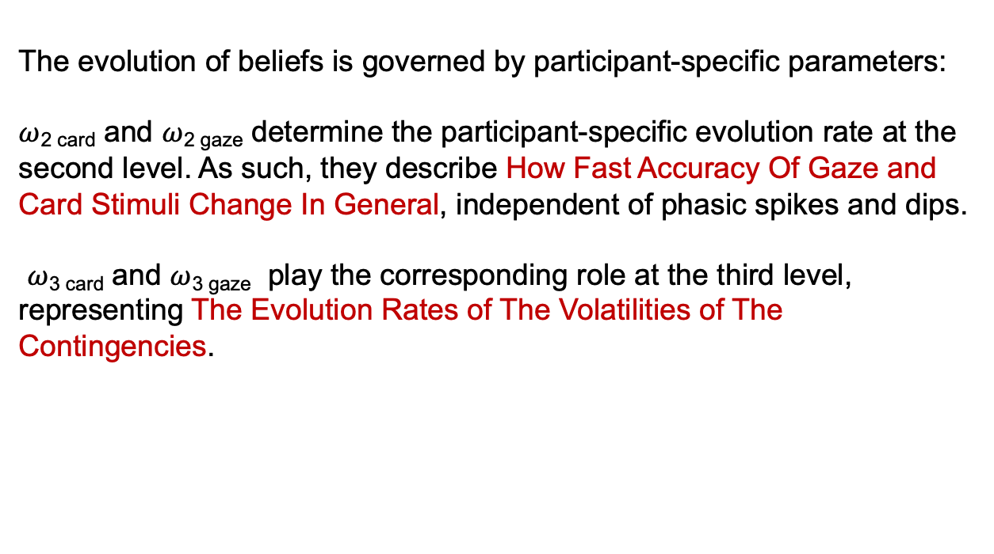
Step2: Perceptual model —— Hierarchical Gaussian Filter
(分层高斯滤波)
The evolution of beliefs is governed by participant-specific parameters:
$ω$_{2 card} and $ω$_{2 gaze} determine the participant-specific evolution rate at the second level. As such, they describe How Fast Accuracy Of Gaze and Card Stimuli Change In General, independent of phasic spikes and dips.
$ω$_{3 card} and $ω$_{3 gaze} play the corresponding role at the third level,
representing The Evolution Rates of The Volatilities of The Contingencies.
Notes:
同时收的Motor execution和motor imagery任务，拿来做localizer

Slide 18
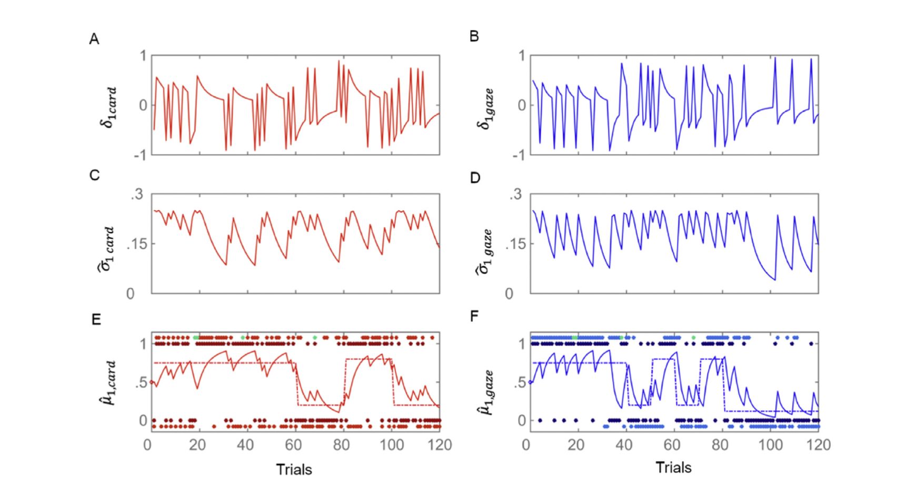
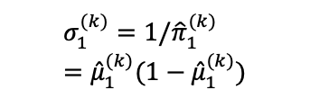

Step2: Perceptual model —— Hierarchical Gaussian Filter
(分层高斯滤波)
$$δ_{1}^{(k)}=u−{\hat{μ}}_{1}^{(k)}$$
$$σ_{1}^{(k)}=1/{\hat{π}}_{1}^{(k)}={\hat{μ}}_{1}^{(k)}(1−{\hat{μ}}_{1}^{(k)})$$
Notes:
同时收的Motor execution和motor imagery任务，拿来做localizer

Slide 19
Step2: Perceptual model —— The Rest 2 Perceptual Models
Perceptual model 2 is a parallel (gaze and card) version of the Sutton K1 model which assumes a learning rate that varies over time as a function of recent prediction errors (Sutton, 1992).
Perceptual model 3 is a parallel classical reinforcement learning model which assumes a learning rate that is fixed and participant-specific (Rescorla & Wagner, 1972).
Notes:
同时收的Motor execution和motor imagery任务，拿来做localizer

Slide 20
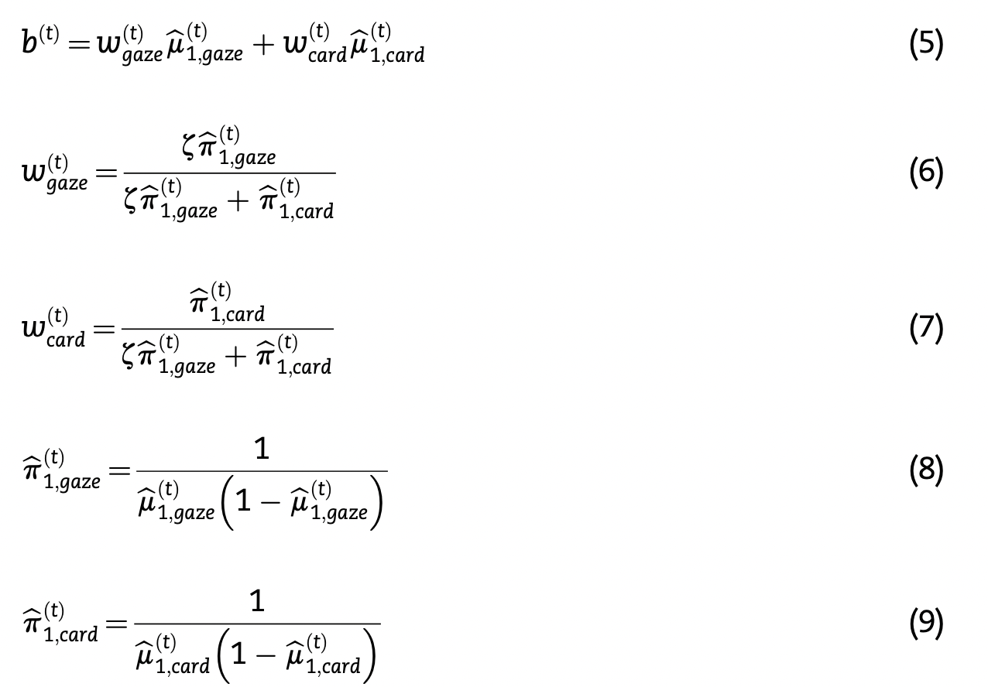
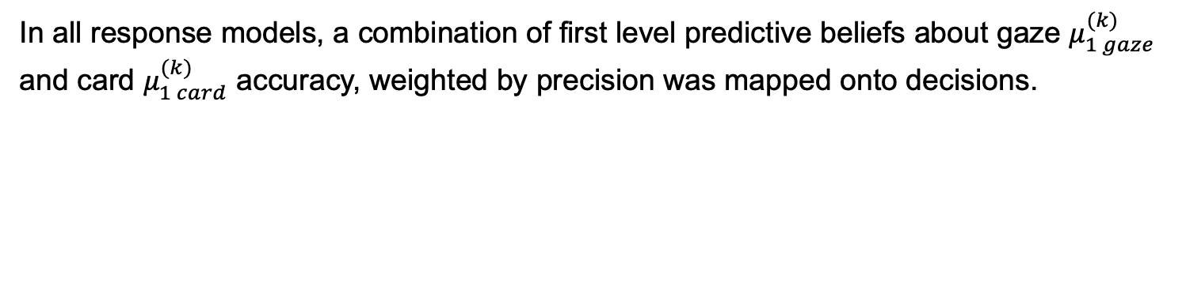
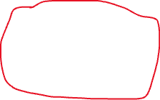
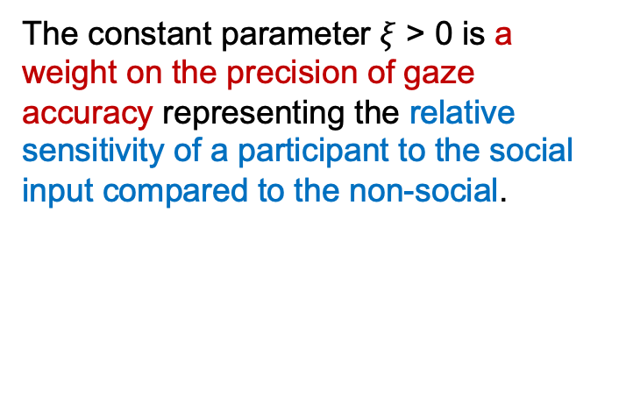
Step2: Response Model
In all response models, a combination of first level predictive beliefs about gaze $μ_{1 gaze}^{(k)}$ and card $μ_{1 card}^{(k)}$ accuracy, weighted by precision was mapped onto decisions.
The constant parameter $ξ$ > 0 is a weight on the precision of gaze accuracy representing the relative sensitivity of a participant to the social input compared to the non-social.
Bernoulli Distribution
Notes:
同时收的Motor execution和motor imagery任务，拿来做localizer

Slide 21
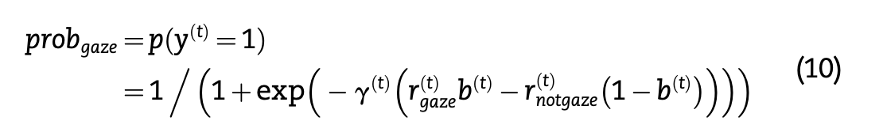
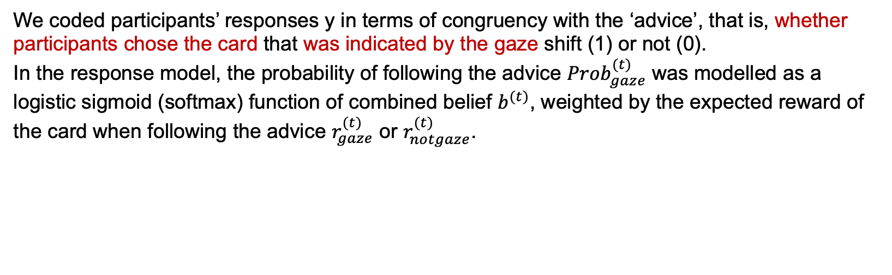
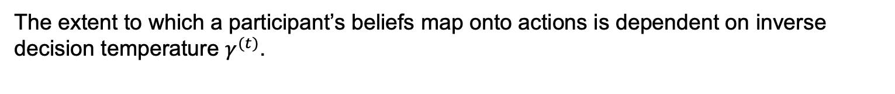
Step2: Response Model
We coded participants’ responses y in terms of congruency with the ‘advice’, that is, whether participants chose the card that was indicated by the gaze shift (1) or not (0).
In the response model, the probability of following the advice ${Prob}_{gaze}^{(t)}$ was modelled as a logistic sigmoid (softmax) function of combined belief $b^{(t)}$, weighted by the expected reward of the card when following the advice $r_{gaze}^{(t)}$ or $r_{notgaze}^{(t)}$.
The extent to which a participant’s beliefs map onto actions is dependent on inverse decision temperature $γ^{(t)}$.
Notes:
同时收的Motor execution和motor imagery任务，拿来做localizer

Slide 22
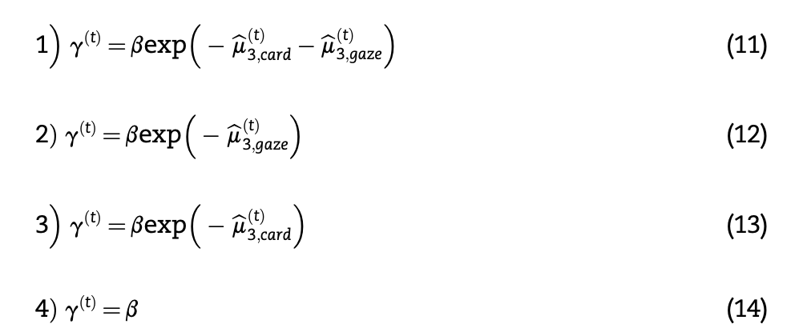
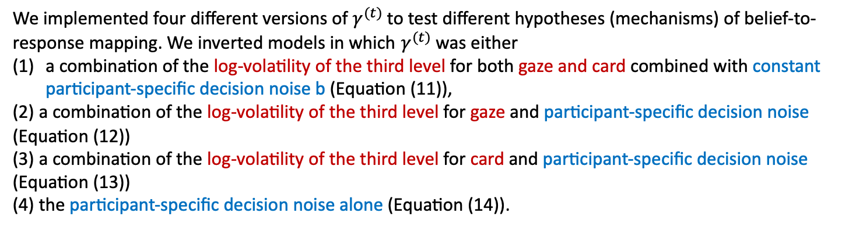
Step2: Response Model
We implemented four different versions of $γ^{(t)}$ to test different hypotheses (mechanisms) of belief-to-response mapping. We inverted models in which $γ^{(t)}$was either
a combination of the log-volatility of the third level for both gaze and card combined with constant participant-specific decision noise b (Equation (11)),
(2) a combination of the log-volatility of the third level for gaze and participant-specific decision noise (Equation (12))
(3) a combination of the log-volatility of the third level for card and participant-specific decision noise (Equation (13))
(4) the participant-specific decision noise alone (Equation (14)).
Model 1
HGF
Model 2、3
Notes:
同时收的Motor execution和motor imagery任务，拿来做localizer

Slide 23




Step2: Response Model
Notes:
同时收的Motor execution和motor imagery任务，拿来做localizer

Slide 24
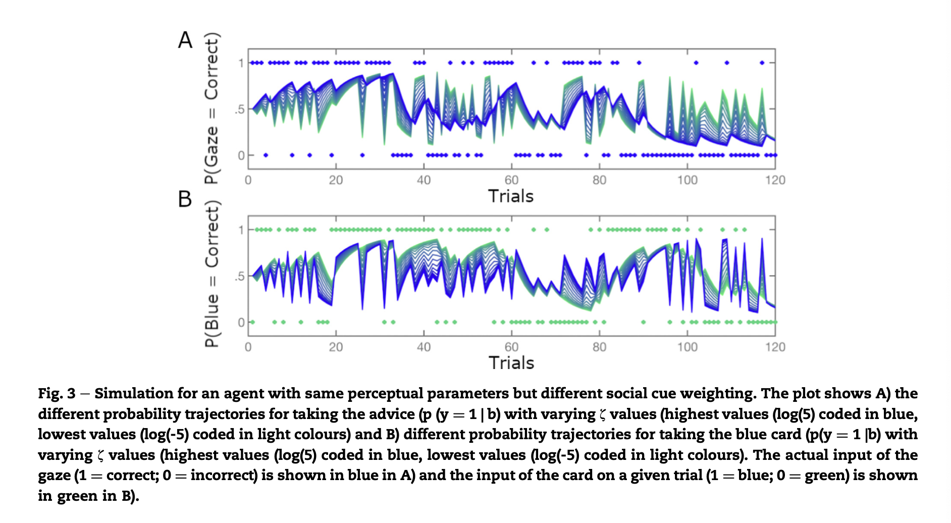
Notes:
同时收的Motor execution和motor imagery任务，拿来做localizer

Slide 25
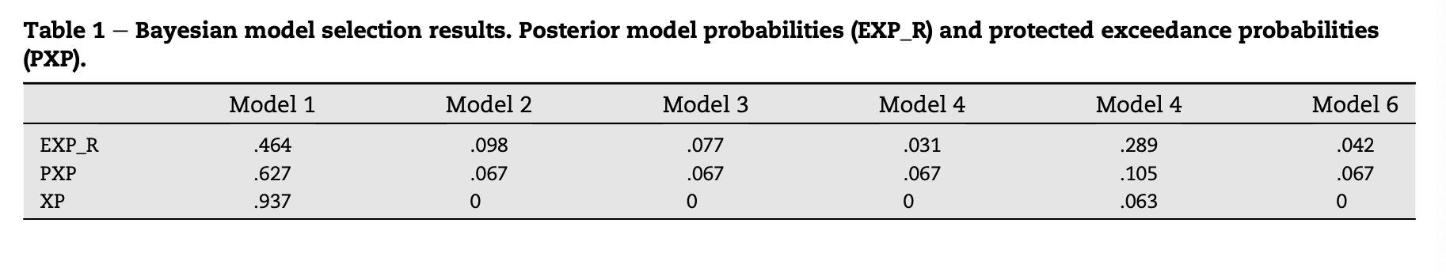
Results : Bayesian Model Comparison & Selection
The expected posterior probabilities (EXP_P) : the probability for each model of it having generated the responses for a randomly chosen participant out of all models in the model space.
（拟合模型外随机被试数据的可能性）
The exceedance probability (XP) and protected exceedance probability (PXP): the probability that a given model better explains the data than any other model in the comparison space.
Therefore, we used this model for all subsequent analyses.
Notes:
同时收的Motor execution和motor imagery任务，拿来做localizer

Slide 26
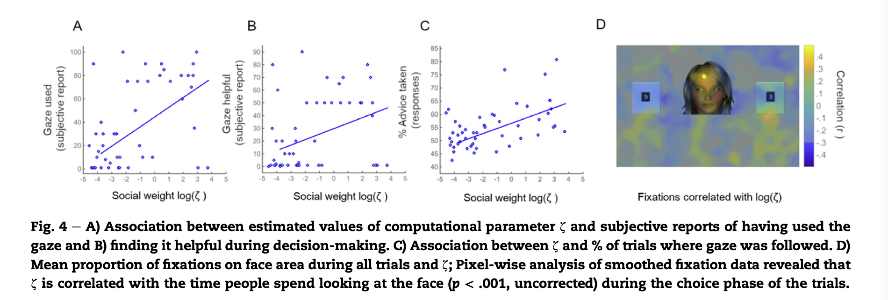
Results : Behavior Data
r_{s}(48) = .453,p=.001
r_{s}(48) = .292,p=.044
r_{s}(48) = .487,p<.001
Notes:
同时收的Motor execution和motor imagery任务，拿来做localizer

Slide 27
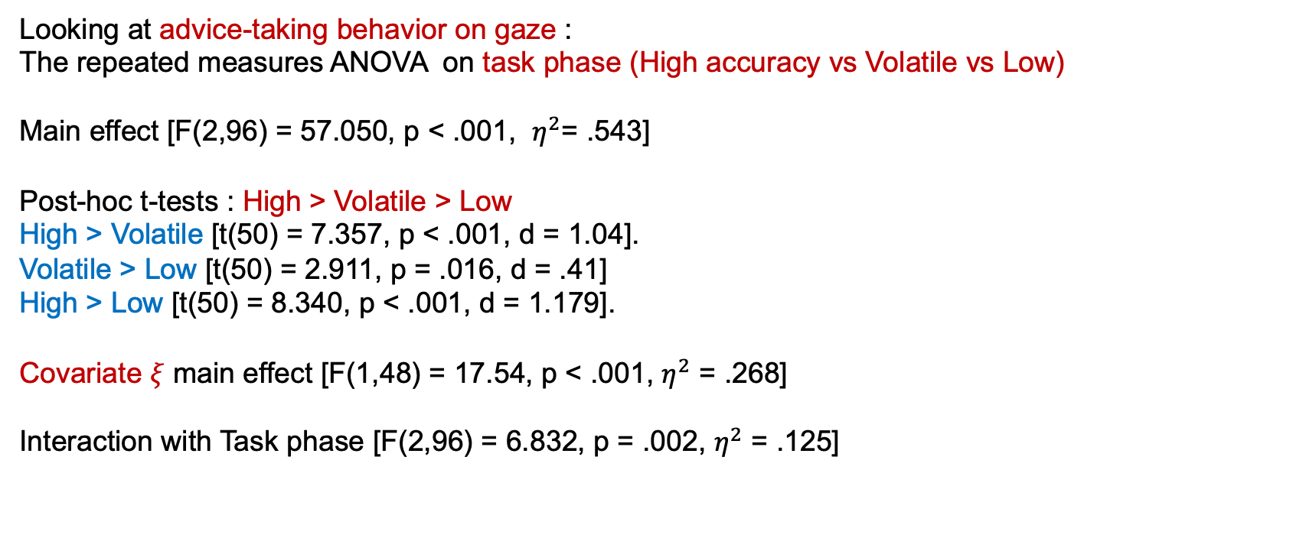
Results : Behavior Data
Looking at advice-taking behavior on gaze :
The repeated measures ANOVA on task phase (High accuracy vs Volatile vs Low)
Main effect [F(2,96) = 57.050, p < .001, $η^{2}$= .543]
Post-hoc t-tests : High > Volatile > Low
High > Volatile [t(50) = 7.357, p < .001, d = 1.04].
Volatile > Low [t(50) = 2.911, p = .016, d = .41]
High > Low [t(50) = 8.340, p < .001, d = 1.179].
Covariate $ξ$ main effect [F(1,48) = 17.54, p < .001, $η^{2}$ = .268]
Interaction with Task phase [F(2,96) = 6.832, p = .002, $η^{2}$ = .125]
Notes:
同时收的Motor execution和motor imagery任务，拿来做localizer

Slide 28
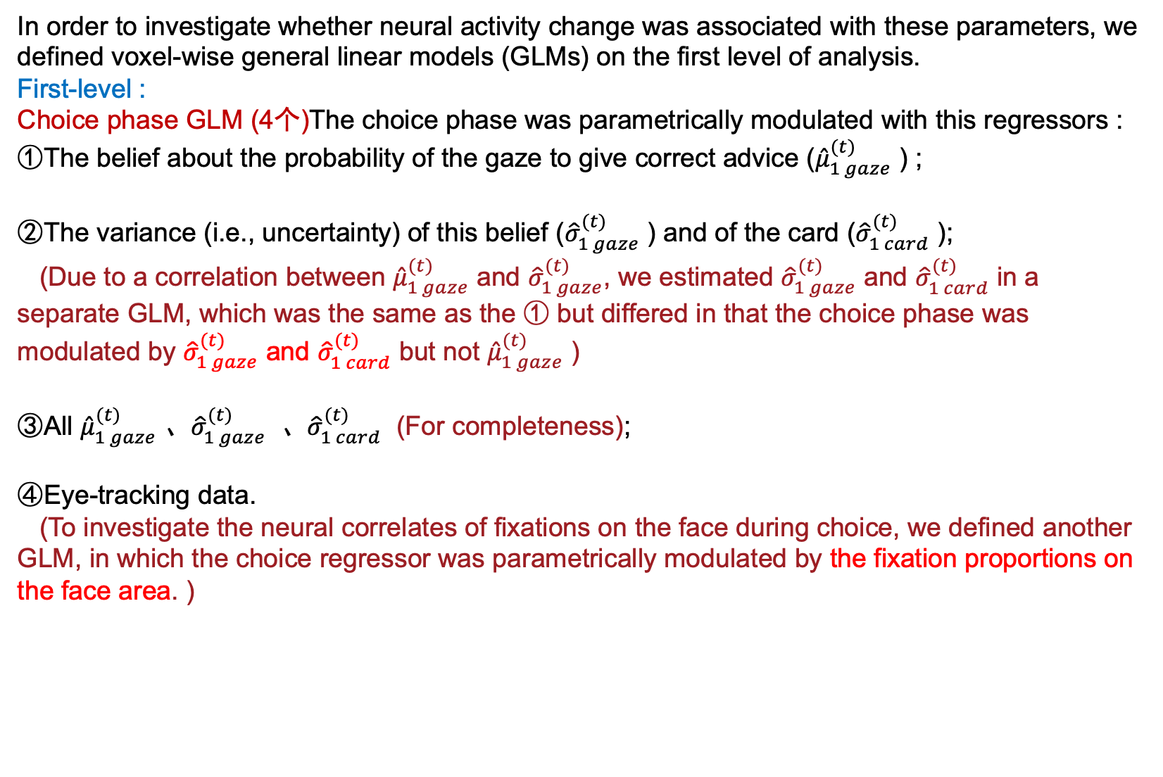
Step3: fMRI Analysis —— First Level
In order to investigate whether neural activity change was associated with these parameters, we defined voxel-wise general linear models (GLMs) on the first level of analysis.
First-level :
Choice phase GLM (4个)The choice phase was parametrically modulated with this regressors :
①The belief about the probability of the gaze to give correct advice (${\hat{μ}}_{1 gaze}^{(t)}$ ) ;
②The variance (i.e., uncertainty) of this belief (${\hat{σ}}_{1 gaze}^{(t)}$ ) and of the card (${\hat{σ}}_{1 card}^{(t)}$ );
(Due to a correlation between ${\hat{μ}}_{1 gaze}^{(t)}$ and ${\hat{σ}}_{1 gaze}^{(t)}$, we estimated ${\hat{σ}}_{1 gaze}^{(t)}$ and ${\hat{σ}}_{1 card}^{(t)}$ in a separate GLM, which was the same as the ① but differed in that the choice phase was modulated by ${\hat{σ}}_{1 gaze}^{(t)}$ and ${\hat{σ}}_{1 card}^{(t)}$ but not ${\hat{μ}}_{1 gaze}^{(t)}$ )
③All ${\hat{μ}}_{1 gaze}^{(t)}$ 、${\hat{σ}}_{1 gaze}^{(t)}$ 、${\hat{σ}}_{1 card}^{(t)}$ (For completeness);
④Eye-tracking data.
(To investigate the neural correlates of fixations on the face during choice, we defined another GLM, in which the choice regressor was parametrically modulated by the fixation proportions on the face area. )
Notes:
同时收的Motor execution和motor imagery任务，拿来做localizer

Slide 29
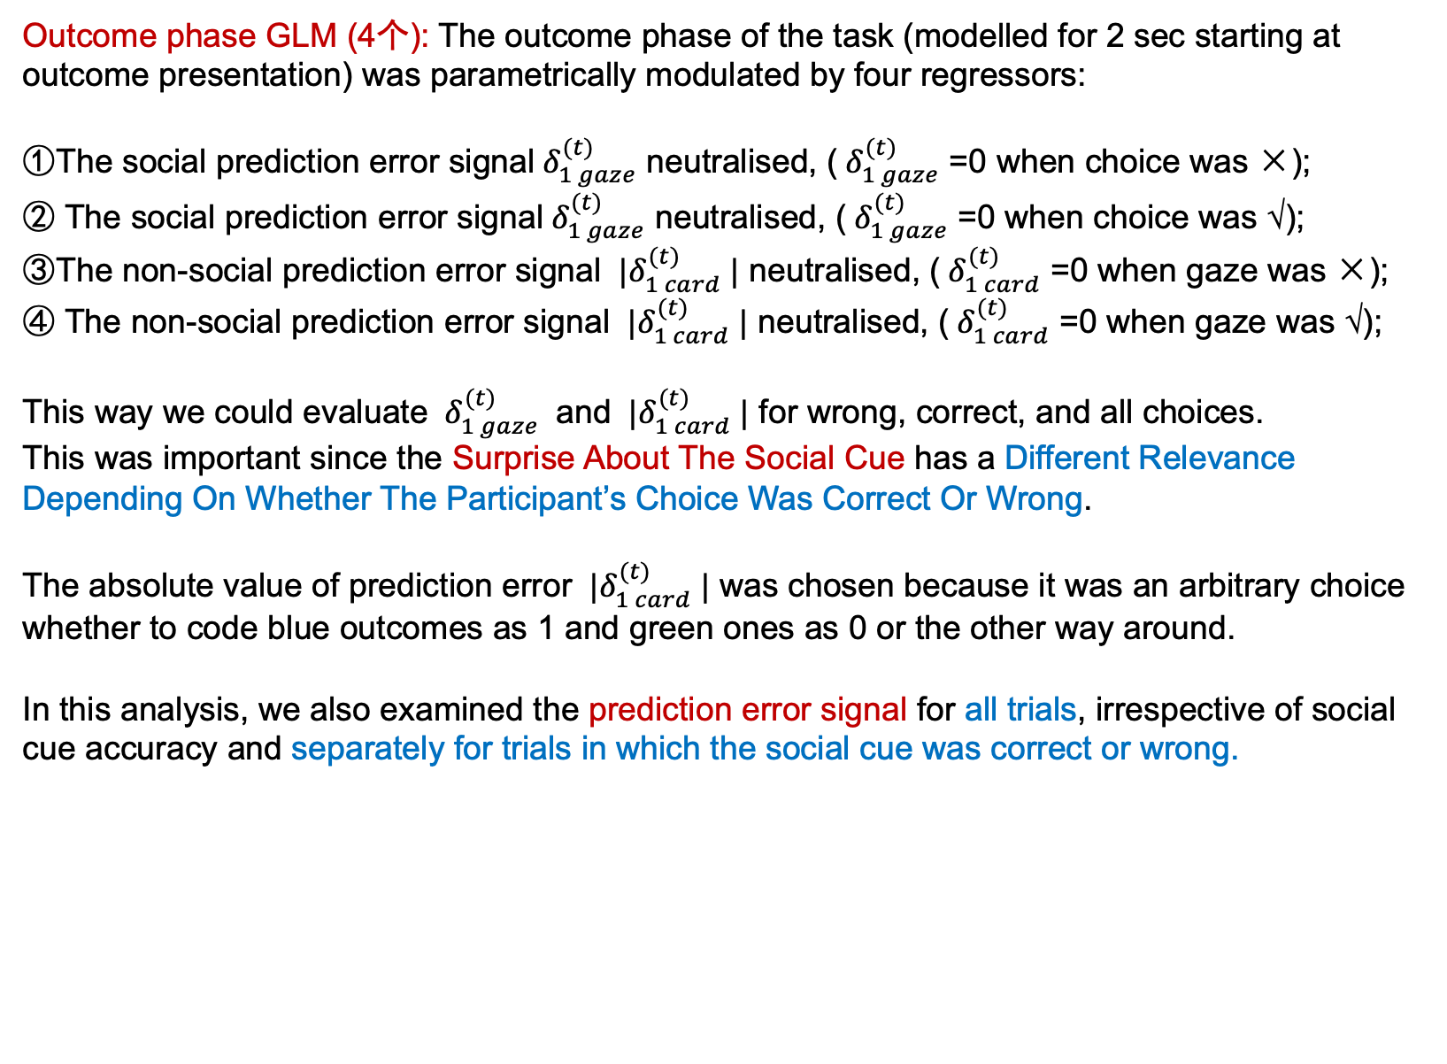
Step3: fMRI Analysis —— First Level
Outcome phase GLM (4个): The outcome phase of the task (modelled for 2 sec starting at outcome presentation) was parametrically modulated by four regressors:
①The social prediction error signal${ δ}_{1 gaze}^{(t)}$ neutralised, (${ δ}_{1 gaze}^{(t)}$ =0 when choice was ×);
② The social prediction error signal${ δ}_{1 gaze}^{(t)}$ neutralised, (${ δ}_{1 gaze}^{(t)}$ =0 when choice was √);
③The non-social prediction error signal ${ |δ}_{1 card}^{(t)} |$ neutralised, (${ δ}_{1 card}^{(t)}$ =0 when gaze was ×);
④ The non-social prediction error signal ${ |δ}_{1 card}^{(t)} |$ neutralised, (${ δ}_{1 card}^{(t)}$ =0 when gaze was √);
This way we could evaluate ${ δ}_{1 gaze}^{(t)}$ and ${ |δ}_{1 card}^{(t)} |$ for wrong, correct, and all choices.
This was important since the Surprise About The Social Cue has a Different Relevance Depending On Whether The Participant’s Choice Was Correct Or Wrong.
The absolute value of prediction error ${ |δ}_{1 card}^{(t)} |$ was chosen because it was an arbitrary choice whether to code blue outcomes as 1 and green ones as 0 or the other way around.
In this analysis, we also examined the prediction error signal for all trials, irrespective of social cue accuracy and separately for trials in which the social cue was correct or wrong.
Notes:
同时收的Motor execution和motor imagery任务，拿来做localizer

Slide 30
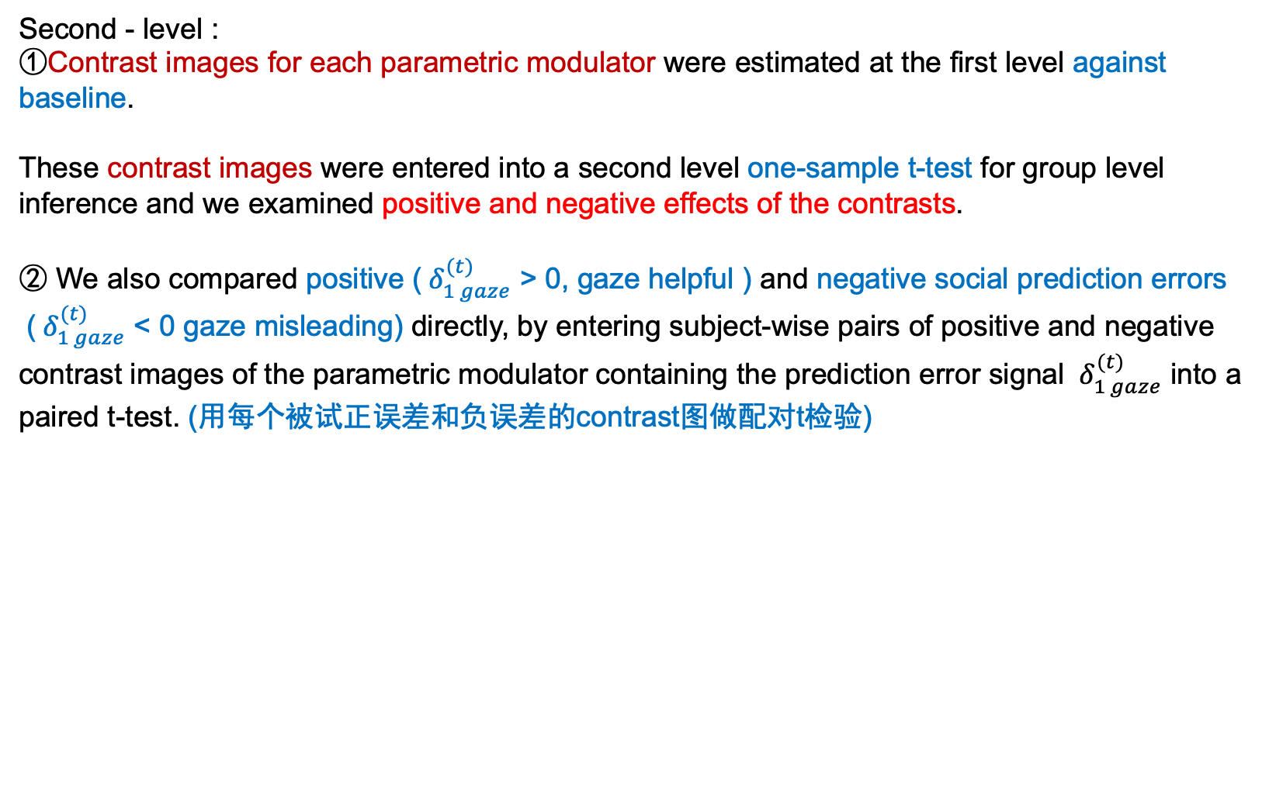
Step3: fMRI Analysis —— Second Level
Second - level :
①Contrast images for each parametric modulator were estimated at the first level against baseline.
These contrast images were entered into a second level one-sample t-test for group level inference and we examined positive and negative effects of the contrasts.
② We also compared positive (${ δ}_{1 gaze}^{(t)}$ > 0, gaze helpful ) and negative social prediction errors
(${ δ}_{1 gaze}^{(t)}$ < 0 gaze misleading) directly, by entering subject-wise pairs of positive and negative contrast images of the parametric modulator containing the prediction error signal ${ δ}_{1 gaze}^{(t)}$ into a paired t-test. (用每个被试正误差和负误差的contrast图做配对t检验)
Notes:
同时收的Motor execution和motor imagery任务，拿来做localizer

Slide 31
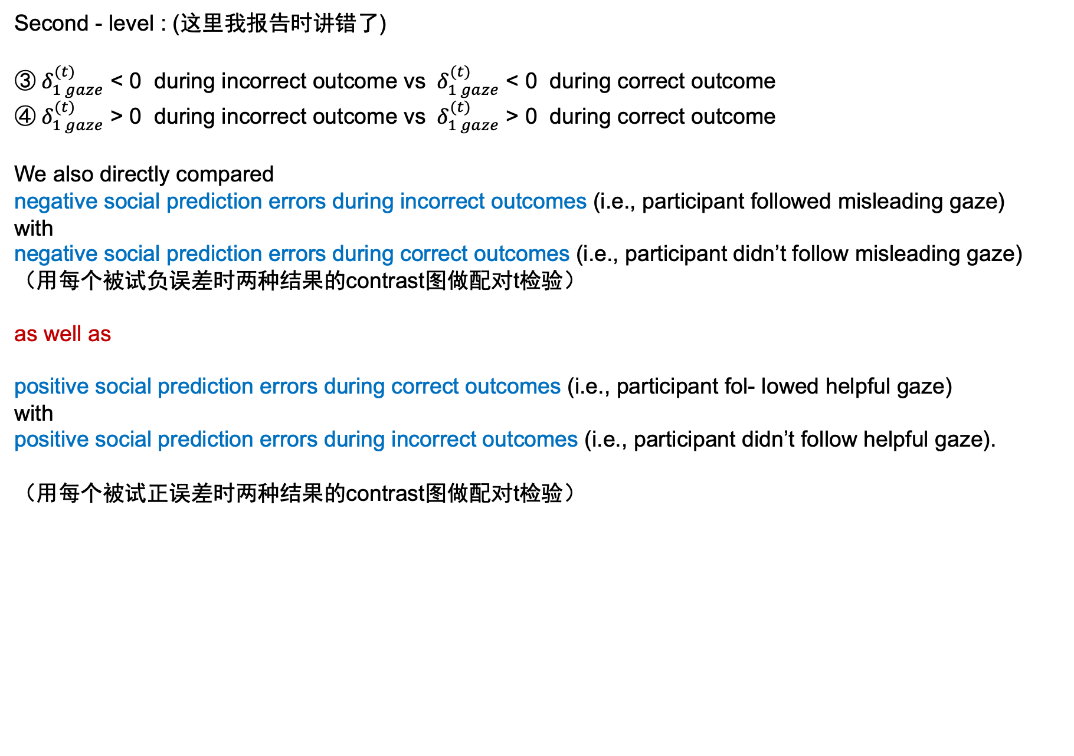
Step3: fMRI Analysis —— Second Level
Second - level : (这里我报告时讲错了)
③${ δ}_{1 gaze}^{(t)}$ < 0 during incorrect outcome vs ${ δ}_{1 gaze}^{(t)}$ < 0 during correct outcome
④${ δ}_{1 gaze}^{(t)}$ > 0 during incorrect outcome vs ${ δ}_{1 gaze}^{(t)}$ > 0 during correct outcome
We also directly compared
negative social prediction errors during incorrect outcomes (i.e., participant followed misleading gaze)
with
negative social prediction errors during correct outcomes (i.e., participant didn’t follow misleading gaze)
（用每个被试负误差时两种结果的contrast图做配对t检验）
as well as
positive social prediction errors during correct outcomes (i.e., participant fol- lowed helpful gaze)
with
positive social prediction errors during incorrect outcomes (i.e., participant didn’t follow helpful gaze).
（用每个被试正误差时两种结果的contrast图做配对t检验）
Notes:
同时收的Motor execution和motor imagery任务，拿来做localizer

Slide 32
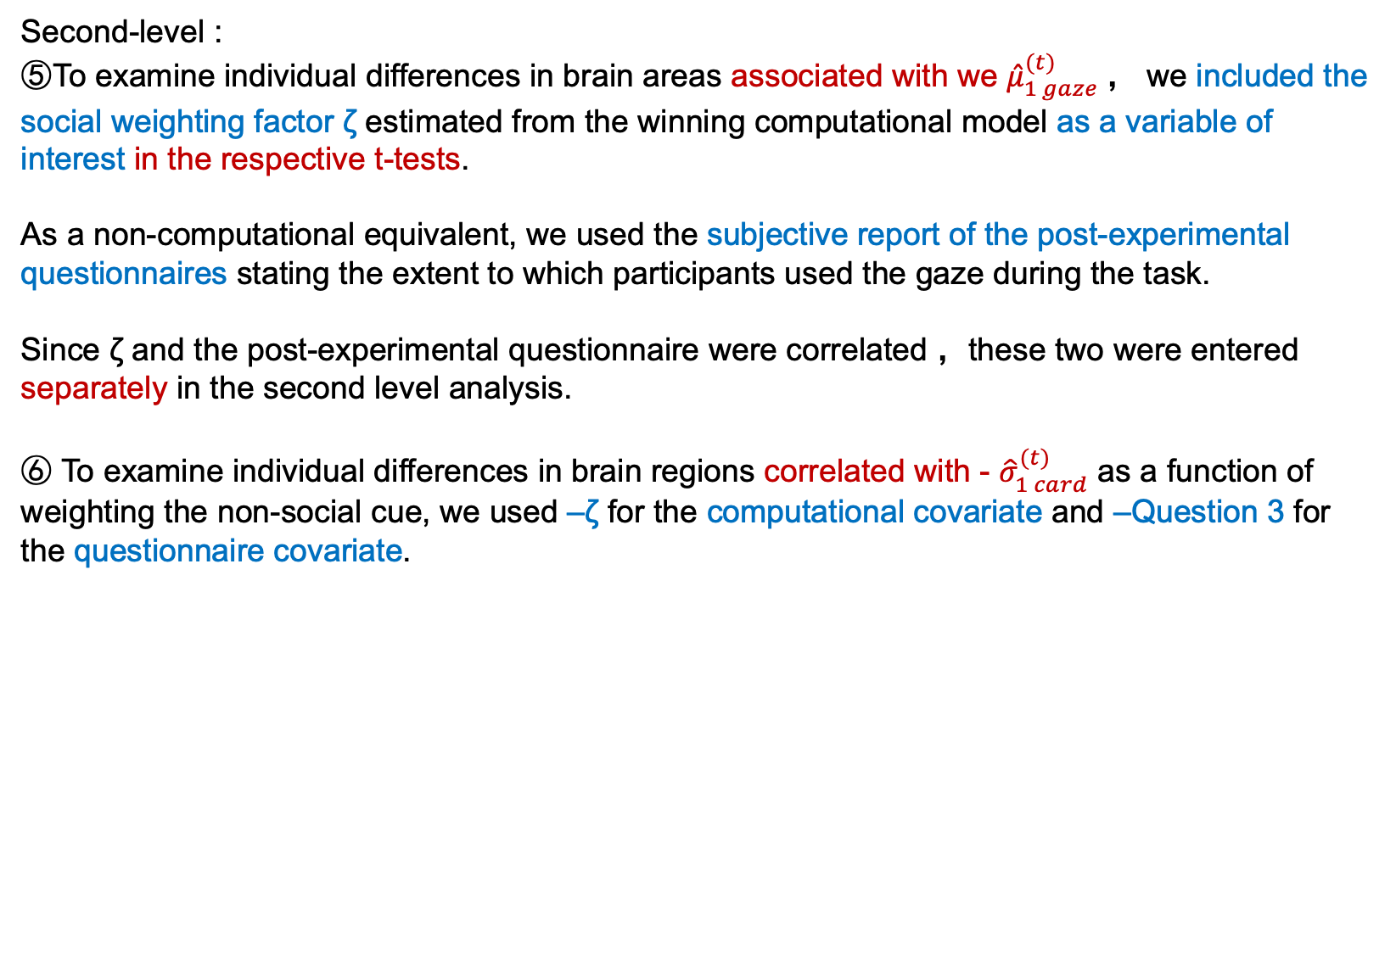
Step3: fMRI Analysis —— Second Level
Second-level :
⑤To examine individual differences in brain areas associated with we ${\hat{μ}}_{1 gaze}^{(t)}$， we included the social weighting factor ζ estimated from the winning computational model as a variable of interest in the respective t-tests.
As a non-computational equivalent, we used the subjective report of the post-experimental questionnaires stating the extent to which participants used the gaze during the task.
Since ζ and the post-experimental questionnaire were correlated ，these two were entered separately in the second level analysis.
⑥ To examine individual differences in brain regions correlated with - ${\hat{σ}}_{1 card}^{(t)}$ as a function of weighting the non-social cue, we used –ζ for the computational covariate and –Question 3 for the questionnaire covariate.
Notes:
同时收的Motor execution和motor imagery任务，拿来做localizer

Slide 33
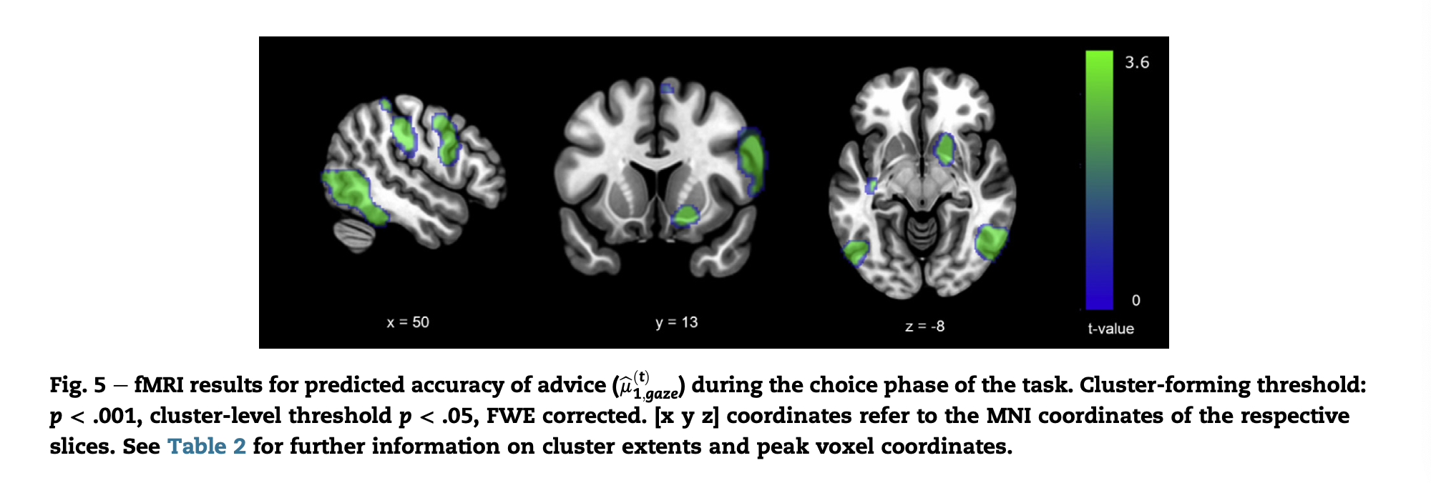
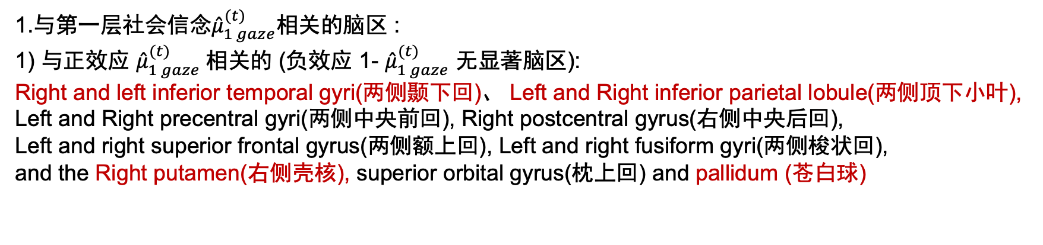
Results : fMRI Data
1.与第一层社会信念${\hat{μ}}_{1 gaze}^{(t)}$相关的脑区 :
1) 与正效应 ${\hat{μ}}_{1 gaze}^{(t)}$相关的 (负效应 1- ${\hat{μ}}_{1 gaze}^{(t)}$ 无显著脑区):
Right and left inferior temporal gyri(两侧颞下回)、 Left and Right inferior parietal lobule(两侧顶下小叶),
Left and Right precentral gyri(两侧中央前回), Right postcentral gyrus(右侧中央后回),
Left and right superior frontal gyrus(两侧额上回), Left and right fusiform gyri(两侧梭状回),
and the Right putamen(右侧壳核), superior orbital gyrus(枕上回) and pallidum (苍白球)
Notes:
同时收的Motor execution和motor imagery任务，拿来做localizer

Slide 34
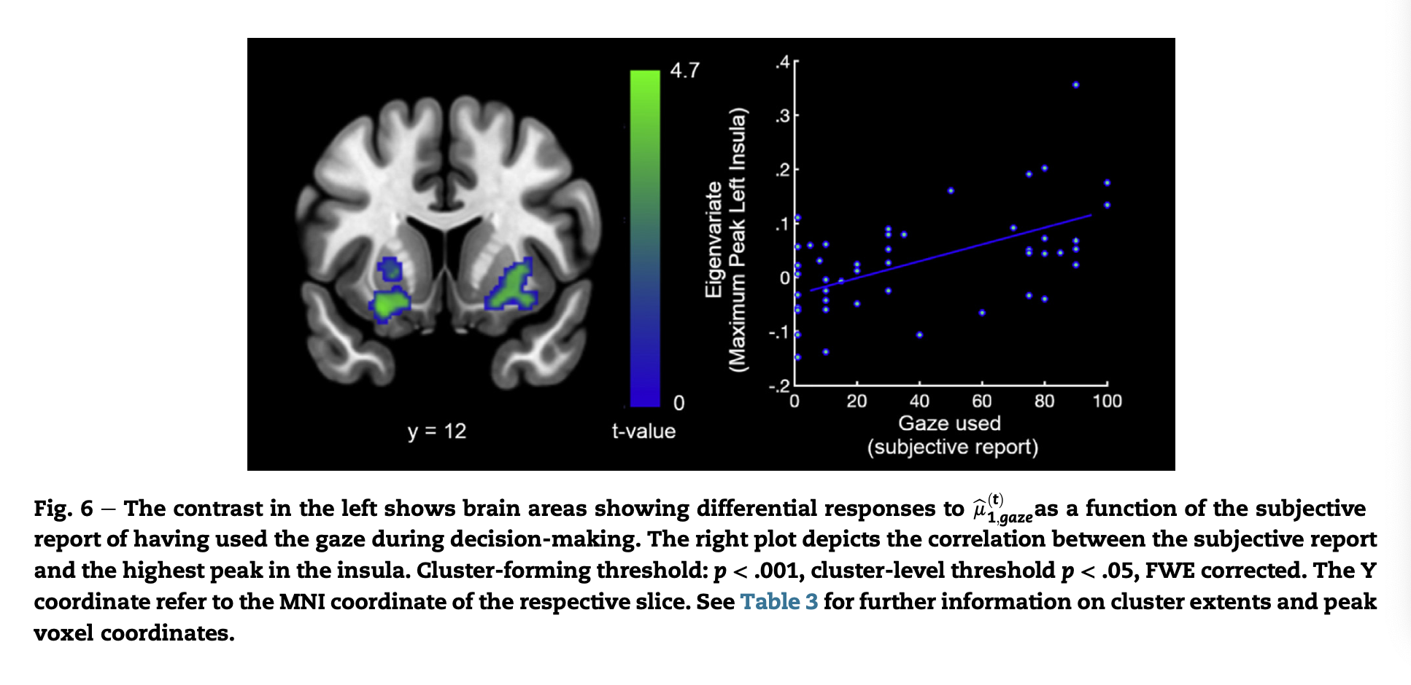
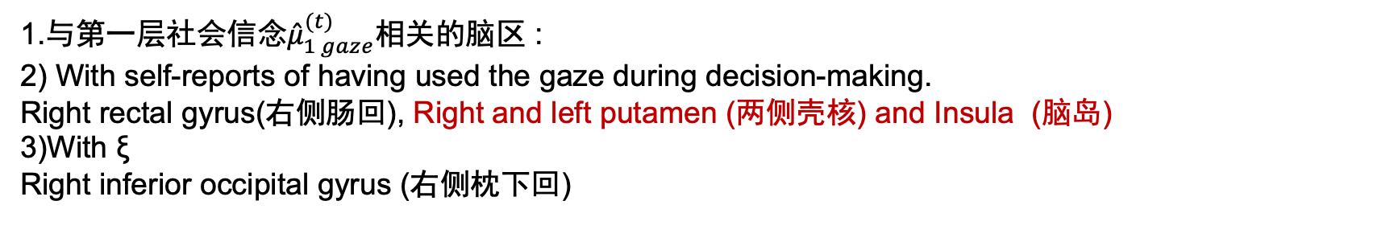
Results : fMRI Data
1.与第一层社会信念${\hat{μ}}_{1 gaze}^{(t)}$相关的脑区 :
2) With self-reports of having used the gaze during decision-making.
Right rectal gyrus(右侧肠回), Right and left putamen (两侧壳核) and Insula (脑岛)
3)With ξ
Right inferior occipital gyrus (右侧枕下回)
Notes:
同时收的Motor execution和motor imagery任务，拿来做localizer

Slide 35
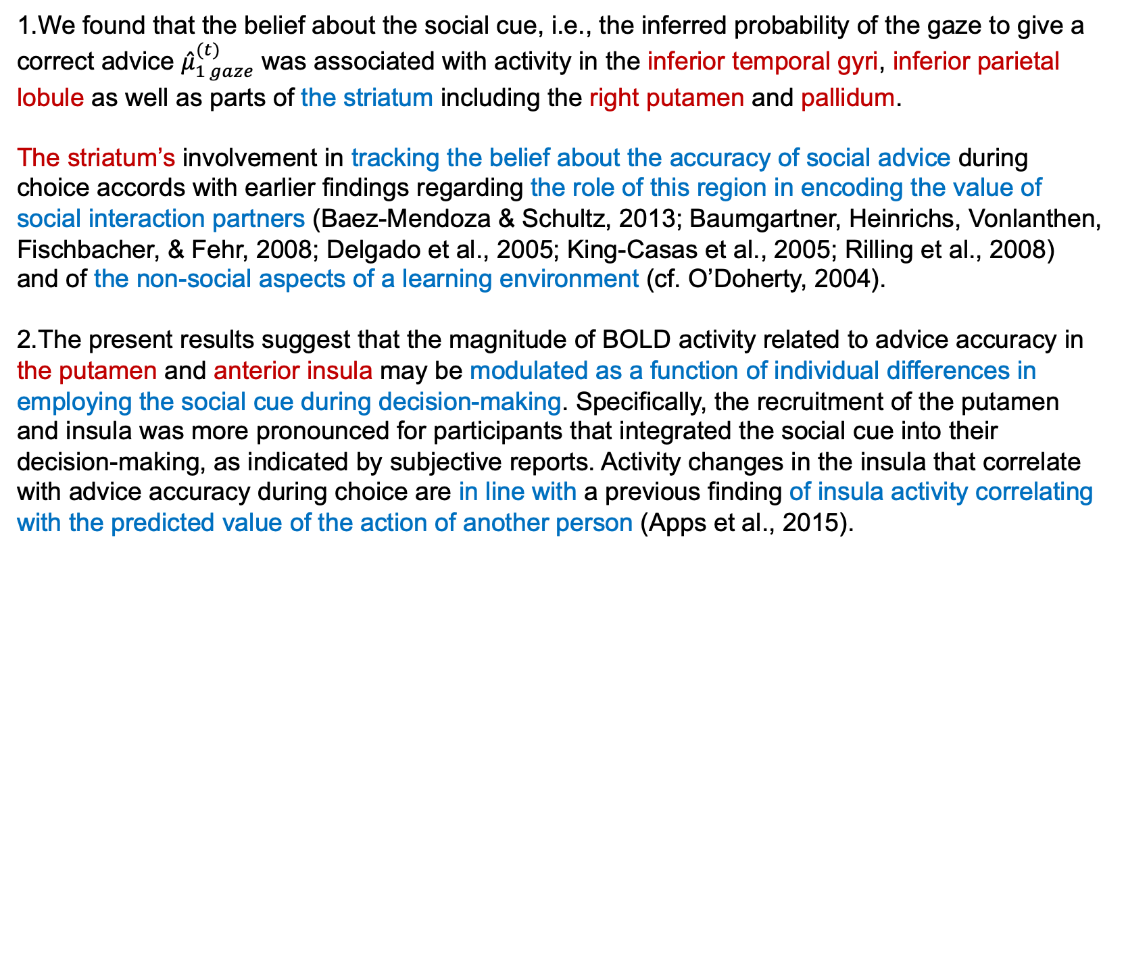
Discussion in ${\hat{μ}}_{1 gaze}^{(t)}$
1.We found that the belief about the social cue, i.e., the inferred probability of the gaze to give a correct advice ${\hat{μ}}_{1 gaze}^{(t)}$ was associated with activity in the inferior temporal gyri, inferior parietal lobule as well as parts of the striatum including the right putamen and pallidum.
The striatum’s involvement in tracking the belief about the accuracy of social advice during choice accords with earlier findings regarding the role of this region in encoding the value of social interaction partners (Baez-Mendoza & Schultz, 2013; Baumgartner, Heinrichs, Vonlanthen, Fischbacher, & Fehr, 2008; Delgado et al., 2005; King-Casas et al., 2005; Rilling et al., 2008) and of the non-social aspects of a learning environment (cf. O’Doherty, 2004).
2.The present results suggest that the magnitude of BOLD activity related to advice accuracy in the putamen and anterior insula may be modulated as a function of individual differences in employing the social cue during decision-making. Specifically, the recruitment of the putamen and insula was more pronounced for participants that integrated the social cue into their decision-making, as indicated by subjective reports. Activity changes in the insula that correlate with advice accuracy during choice are in line with a previous finding of insula activity correlating with the predicted value of the action of another person (Apps et al., 2015).
Notes:
同时收的Motor execution和motor imagery任务，拿来做localizer

Slide 36
Discussion in ${\hat{μ}}_{1 gaze}^{(t)}$
3. Our finding that putamen and insula activities were correlated with increased weighting of social information needs to be seen in light of a limitation of the current study: we did not have a non-social control condition, for instance in form of an arrow pointing to one of the cards.
Therefore, we cannot fully determine whether individual differences in social cue weighting associated with insula and putamen activity can be attributed to purely social or more general learning processes.
In fact, co-activation of putamen and insula has previously been found in non-social cueing tasks (Hopfinger, Buonocore, & Mangun, 2000). Remarkably however, these regions show significantly stronger activations for directional gaze cues compared to arrows in a spatial cueing task in healthy participants (Greene et al., 2011).
Notes:
同时收的Motor execution和motor imagery任务，拿来做localizer

Slide 37
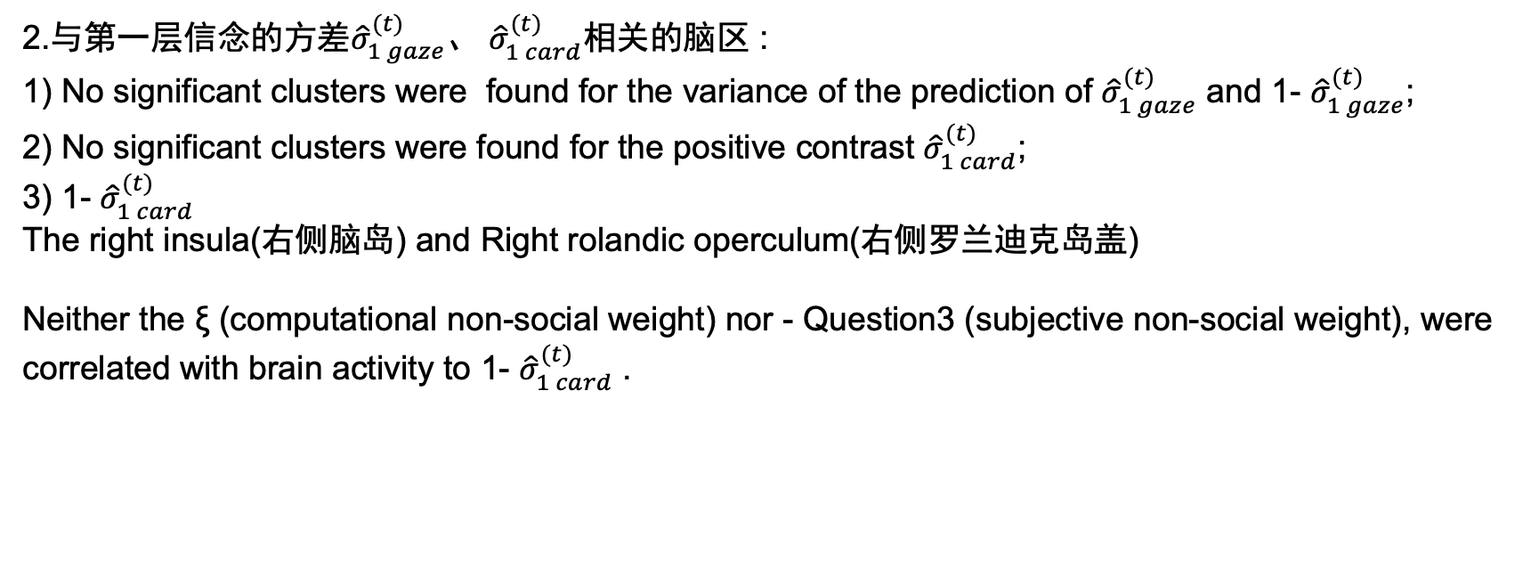
Results : fMRI Data
2.与第一层信念的方差${\hat{σ}}_{1 gaze}^{(t)}$、 ${\hat{σ}}_{1 card}^{(t)}$相关的脑区 :
1) No significant clusters were found for the variance of the prediction of ${\hat{σ}}_{1 gaze}^{(t)}$ and 1- ${\hat{σ}}_{1 gaze}^{(t)}$;
2) No significant clusters were found for the positive contrast ${\hat{σ}}_{1 card}^{(t)}$;
3) 1- ${\hat{σ}}_{1 card}^{(t)}$
The right insula(右侧脑岛) and Right rolandic operculum(右侧罗兰迪克岛盖)
Neither the ξ (computational non-social weight) nor - Question3 (subjective non-social weight), were correlated with brain activity to 1- ${\hat{σ}}_{1 card}^{(t)}$ .
Notes:
同时收的Motor execution和motor imagery任务，拿来做localizer

Slide 38
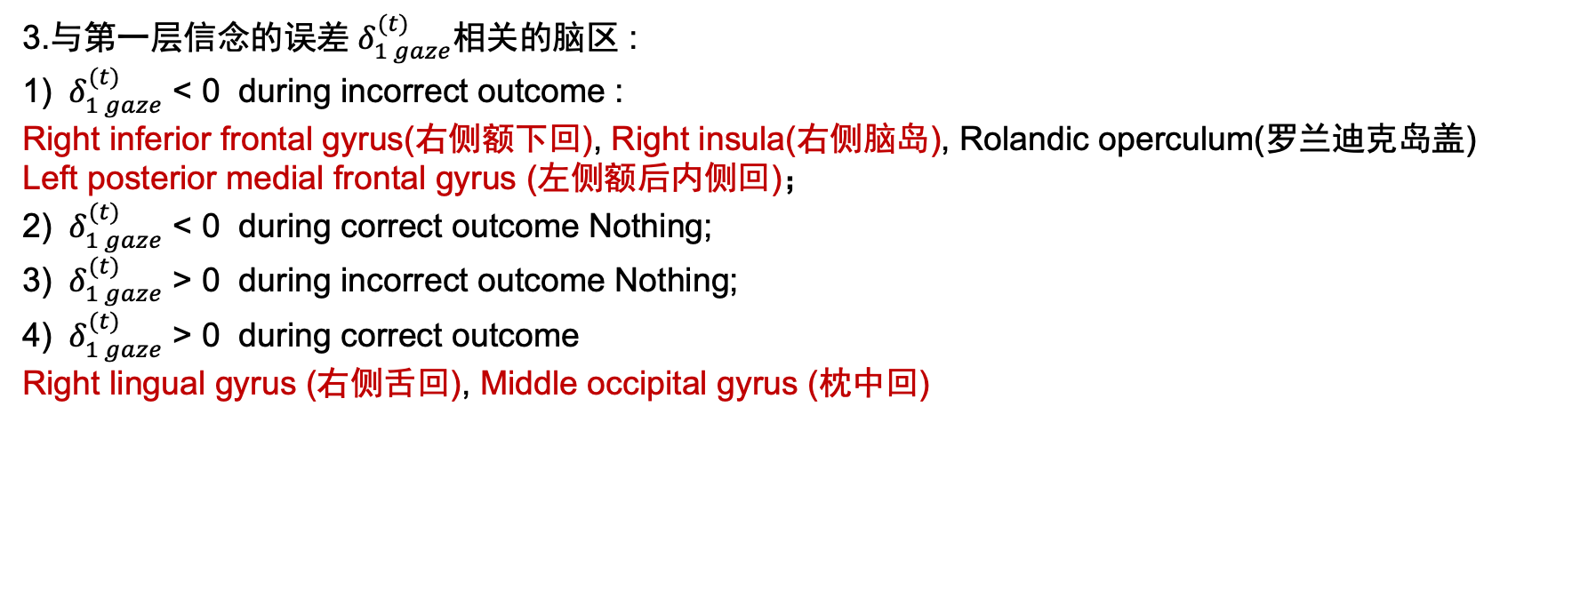
Results : fMRI Data
3.与第一层信念的误差${ δ}_{1 gaze}^{(t)}$相关的脑区 :
1) ${ δ}_{1 gaze}^{(t)}$ < 0 during incorrect outcome :
Right inferior frontal gyrus(右侧额下回), Right insula(右侧脑岛), Rolandic operculum(罗兰迪克岛盖)
Left posterior medial frontal gyrus (左侧额后内侧回)；
2) ${ δ}_{1 gaze}^{(t)}$ < 0 during correct outcome Nothing;
3) ${ δ}_{1 gaze}^{(t)}$ > 0 during incorrect outcome Nothing;
4) ${ δ}_{1 gaze}^{(t)}$ > 0 during correct outcome
Right lingual gyrus (右侧舌回), Middle occipital gyrus (枕中回)
Notes:
同时收的Motor execution和motor imagery任务，拿来做localizer

Slide 39
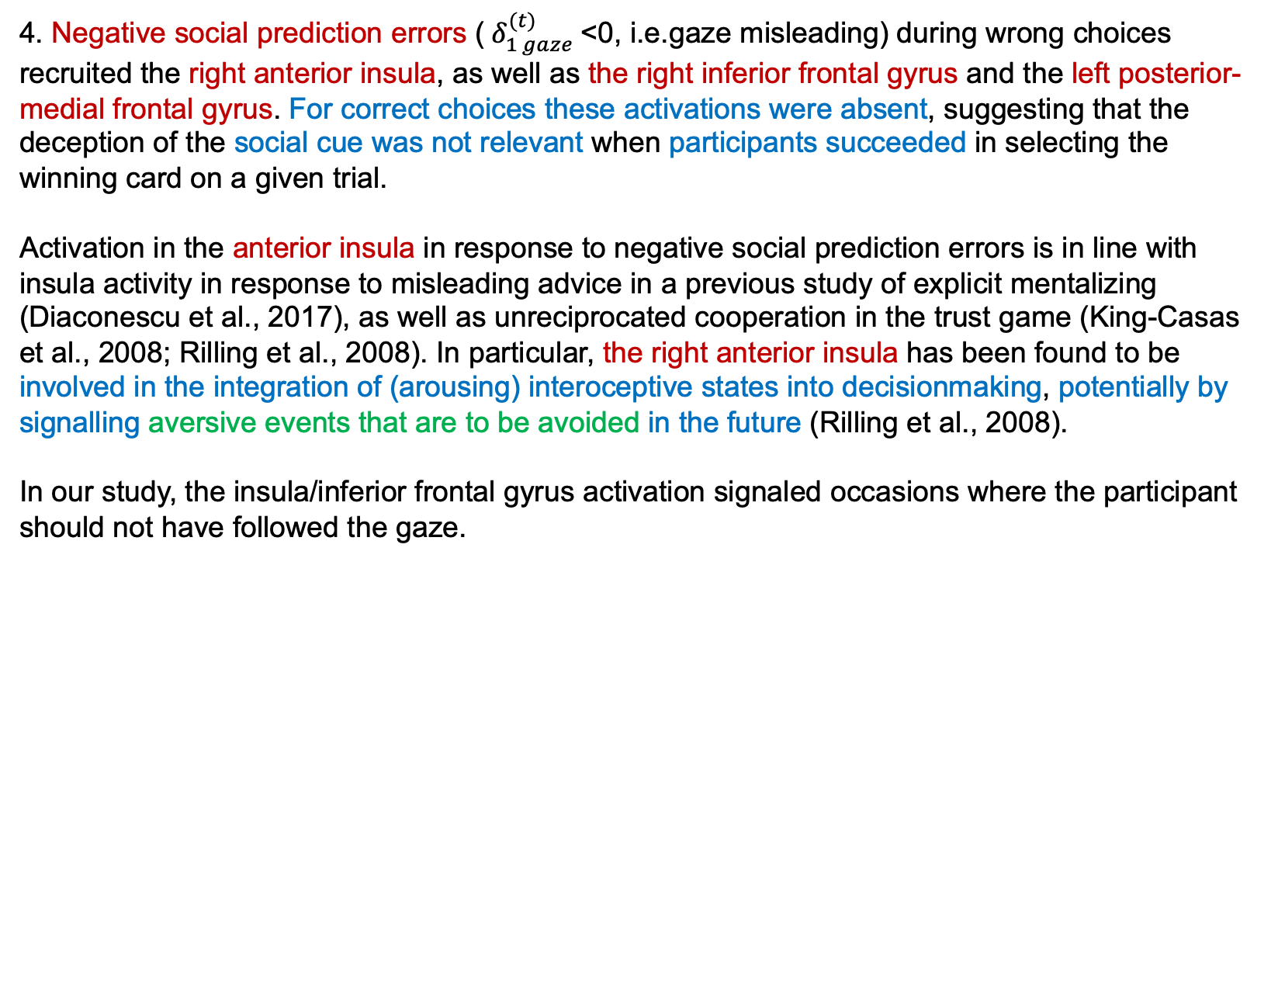
Discussion in${ δ}_{1 gaze}^{(t)}$
4. Negative social prediction errors (${ δ}_{1 gaze}^{(t)}$<0, i.e.gaze misleading) during wrong choices recruited the right anterior insula, as well as the right inferior frontal gyrus and the left posterior-medial frontal gyrus. For correct choices these activations were absent, suggesting that the deception of the social cue was not relevant when participants succeeded in selecting the winning card on a given trial.
Activation in the anterior insula in response to negative social prediction errors is in line with insula activity in response to misleading advice in a previous study of explicit mentalizing (Diaconescu et al., 2017), as well as unreciprocated cooperation in the trust game (King-Casas et al., 2008; Rilling et al., 2008). In particular, the right anterior insula has been found to be involved in the integration of (arousing) interoceptive states into decisionmaking, potentially by signalling aversive events that are to be avoided in the future (Rilling et al., 2008).
In our study, the insula/inferior frontal gyrus activation signaled occasions where the participant should not have followed the gaze.
Notes:
同时收的Motor execution和motor imagery任务，拿来做localizer

Slide 40
Discussion in${ δ}_{1 gaze}^{(t)}$
5. For positive social prediction errors (gaze more helpful than predicted) during correct outcomes, we found activity in the right occipital and lingual gyrus but not in reward-associated areas as reported by others (Biele, Rieskamp, Krugel, & Heekeren, 2011; Delgado, Frank, & Phelps, 2005; Fareri, Chang, & Delgado, 2012; Fouragnan et al., 2013).
This may reflect the directing of visual attention towards relevant, in our case, social stimuli. Indeed, reward learning signals were previously also found in the occipital cortex by Payzan- LeNestour, Dunne, Bossaerts, and O’Doherty (2013).
Notes:
同时收的Motor execution和motor imagery任务，拿来做localizer

Slide 41
Discussion in${ δ}_{1 gaze}^{(t)}$
6.In the present study, social prediction errors did not significantly activate brain regions that have been associated with mentalization, such as the TPJ or the dmPFC (Behrens et al., 2008; Diaconescu et al., 2017; Koster-Hale et al., 2017) or that have been associated with observational learning such as the ACCg (Apps et al., 2016, 2015; Lockwood et al., 2015).
A crucial difference between the present and other social learning studies is that our study did not involve instruction with respect to an opponent or confederate（无指导）. Instead, we merely presented the computer-generated face because we wanted to investigate the spontaneous integration of social information into decision making（自发的社会信息整合）.
Indeed, a subgroup of our participants claimed not to have used the social information during the task. Possibly, these participants concentrated more on the non-social feedback to predict the outcome, relying less on social feedback to adapt their behavior, thus reducing statistical power to detect effects of social inference in the group analysis.
Notes:
同时收的Motor execution和motor imagery任务，拿来做localizer

Slide 42
Conclusion
The present study used model-based fMRI to demonstrate commonalities and differences in the neural mechanisms of social and non-social cue integration during learning and decision-making.
While activations related to the non-social cue were associated with activity change in the middle and anterior cingulate and insula, negative social prediction errors additionally extended into the inferior frontal gyrus.
During decision-making, tracking the uncertainty of the non-social cue was associated with activity change in the insula, while tracking the probabilistic accuracy of the social cue showed activity in the inferior temporal gyrus, putamen and pallidum, regions known for their relevance in reward-based processing. The putamen and the insula showed activity as a function of individual differences in weighting the social cue during decision-making.
Notes:
同时收的Motor execution和motor imagery任务，拿来做localizer

Slide 43
谢谢大家
Notes:
同时收的Motor execution和motor imagery任务，拿来做localizer

